Slide 1

Python Bytes
Week 3 - C.Y.O.A Work Day

Slide 2
TABLE OF CONTENTS
01
Class Info
04
Last Week Recap
02
05
HW Check
While Loops
03
06
Quick Refresher
Break & Continue Statements

Slide 3
01
Class Info
All Resources can be found in: tinyurl.com/Python-Bytes-2026

Slide 4
HW Check

Slide 5
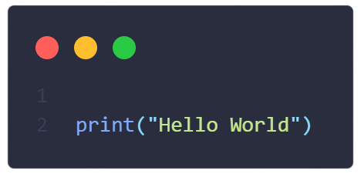
03
Quick Refresher
1. print(“print(\”Py\n3\”)”) output?
A.
Py
3
B.
print(\”Py\n3\”)
C.
print(“Py
3”)
D.
\”Py\n3\”

Slide 6

03
Quick Refresher
2. print(f”Alex has {2+3*6} apples”) output
A.
TypeError - cannot concatenate “str” and “int” objects
B.
Alex has {2+3*6} apples
C.
Alex has 30 apples
D.
Alex has 20 apples

Slide 7

03
Quick Refresher
3. What is this equal to: (6 // 4) ** (7 % 4)
A.
3.375
B.
1
C.
4.5
D.
3

Slide 8
03
Quick Refresher
4. What is a boolean?
A.
A type of Polish broth
B.
boolean() bolds text. To print, do print(boolean(“”))
C.
booleans are data types that can be True or False
D.
booleans are data types that are either And or Or

Slide 9
03
Quick Refresher
5. What are the 3 conditional statements we learned?
A.
if, elif, else
B.
if, else if, else
C.
switch, case, default
D.
and, or, xor

Slide 10
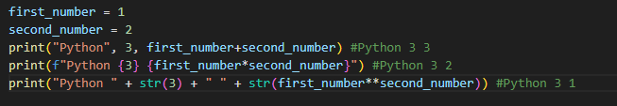
04
Last Week Recap
Print statements and Mathematics
print(item1, item2, item3, …) prints out the items – different data types are fine.
print(f”This is a string, the following is a variable: {my_var}”) different data types can be added using the {} and f”” notation here.
Math has +, -, *, /, //, %, **
/ always returns float, and // always return the truncated version.
  Float if at least one is a float.
% returns the remainder, ** is exponentiation.

Slide 11
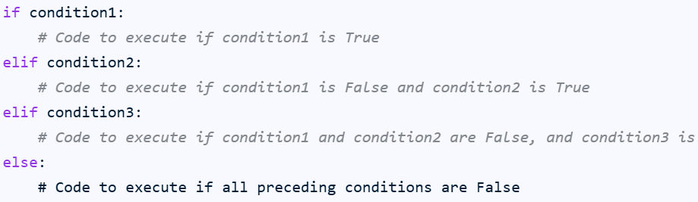
04
Last Week Recap
Conditionals
How you make decisions in your code and booleans
Commonly known as if-statements
Basic syntax:

Slide 12
05
C.Y.O.A Project
This will be your first ever mini-project in this class!
Objective: To make a fun text adventure game in Python
What will you need to use? Everything we’ve learned so far!
    print() statements, input() statements
    Variables
    Conditionals
    Converting Data Types
    Mathematics in Python
Let us know if you need help with anything, but we will letting y’all code independently
Not meant to be challenging or serious, so go wild and have fun!

Slide 13
06
C.Y.O.A Project Demos
Part of programming is showing off what you’ve done, so that’s what you are going to be doing!
We’ll randomly choose someone with a wheel
In your demo make sure to:
  Explain your inspiration/what your project is based on
  Go over the entire adventure (unless its super long…)
  Go a bit over the code. What was fun? What was challenging?
  What you would do if you had more time
Don’t stress, this is just to see what y’all did

Slide 14
Thats It!
Remember to clean up and stack chairs!

